Slide 1

Business Insights 360 AtliQ Hardware

Slide 2
About AtliQ
AtliQ Hardware is a leading global consumer electronics company with a diverse portfolio.
It specializes in PCs, monitors, and accessories such as mouse, and more
The company has a strong presence across multiple countries and is steadily establishing global recognition.

Slide 3
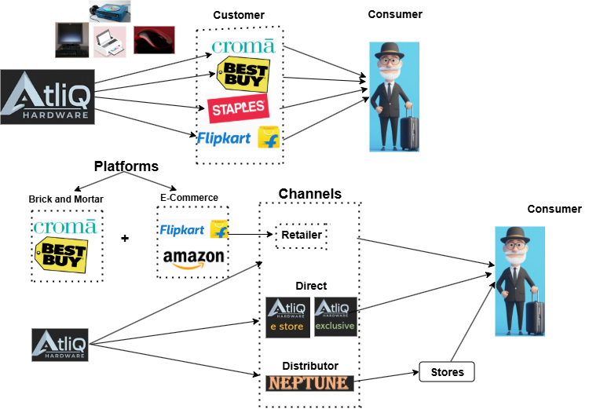
Business Model

Slide 4

Markets / Customers 27 distinct markets and 75 distinct customers
Asia Pacific Australia, Bangladesh, China, India, Indonesia, Japan, New Zealand, Pakistan, Philippines, South Korea
North America Canada, USA
Latin America Brazil, Chile, Columbia, Mexico
European Union Austria, France, Germany, Italy, Netherlands, Norway, Poland, Portugal, Spain, Sweden, UK

Slide 5

Products
Accessories Keyboard, Mouse, Batteries
Notebook Personal laptop, Gaming laptop, Business laptop.
Storage External solid-state drives, USB flash drives
Peripherals Processors, Graphic cards, Motherboard, Internal HDD
Desktop Business laptop, Personal laptop
Networking Wi-fi extender.

Slide 6


Challenges Driving the Need for Data Analytics
A tough experience in Latin America taught the team that intuition alone can be risky; relying only on surveys wasn’t enough for big decisions.
Facing a strong competitor like Dell, who uses advanced analytics on customer demographics and consumption behavior, AtliQ needs to level up.
Project kick-off: the focus is now on onboarding data analytics—moving from Excel to Power BI for smarter, data-driven decisions.

Slide 7
Objectives
Analyze AtliQ hardware consumption patterns and identify opportunities to improve sales and revenue.
Ensure transparency in performance metrics and enable data-driven decisions to prevent incidents like the one in Latin America.
Provide actionable insights to enhance competitiveness and grow market share.

Slide 8
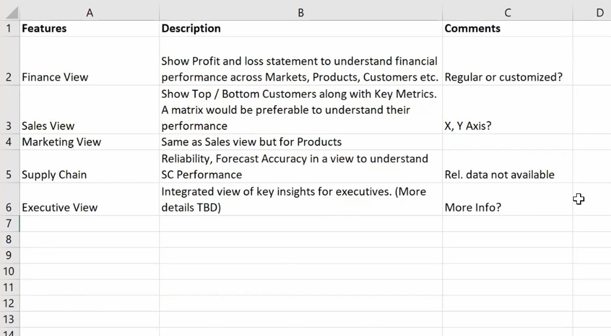

Project Kick-Off Meeting: Actionable Notes

Slide 9
Features of the Project
Finance View
Arms the Finance team with actionable P&L insights across markets, products, and customers.
Drives smarter financial decisions by pinpointing profit drivers and cost trends.
Sales View
Highlights top and low-performing products, empowering the Sales team to act fast.
Boosts revenue by focusing efforts where they matter most.
Marketing View
Gives the Marketing team a clear view of product performance and growth blockers.
Accelerates market growth by optimizing campaigns and prioritizing high-impact products.
Supply Chain View
Delivers key metrics on reliability, inventory, and forecast accuracy to the Supply Chain team.
Maximizes efficiency, reduces stockouts, and strengthens operational resilience.
Executive View
Integrates critical insights from all business functions for the CEO and leadership team.
Enables rapid, data-driven decisions that drive strategic growth.

Slide 10
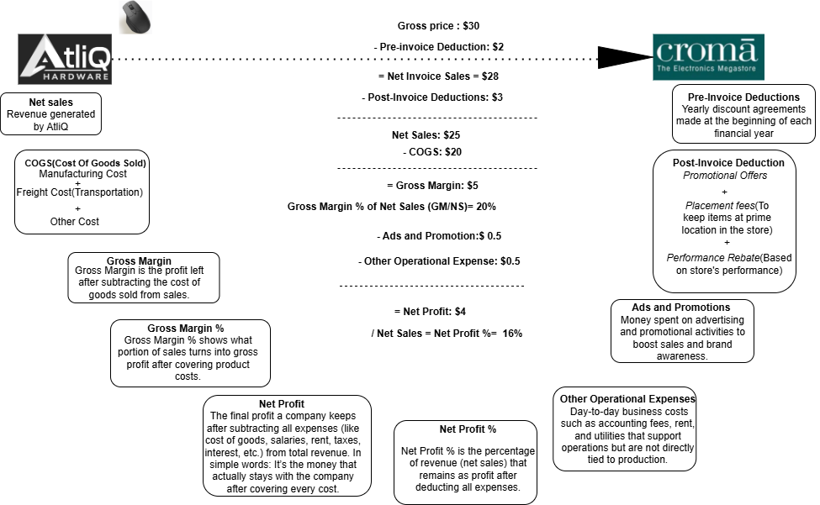

Slide 11
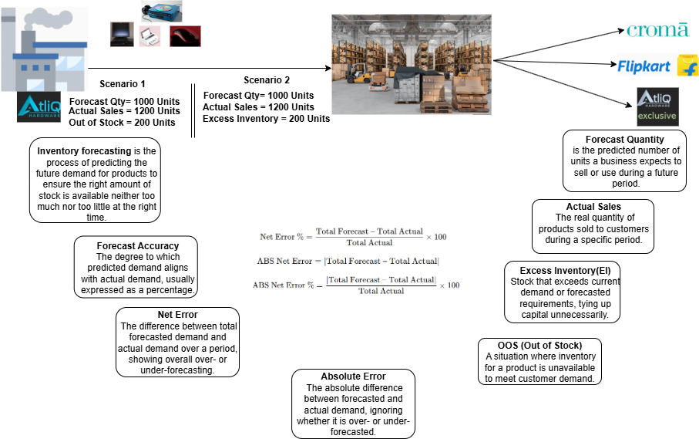

Slide 12
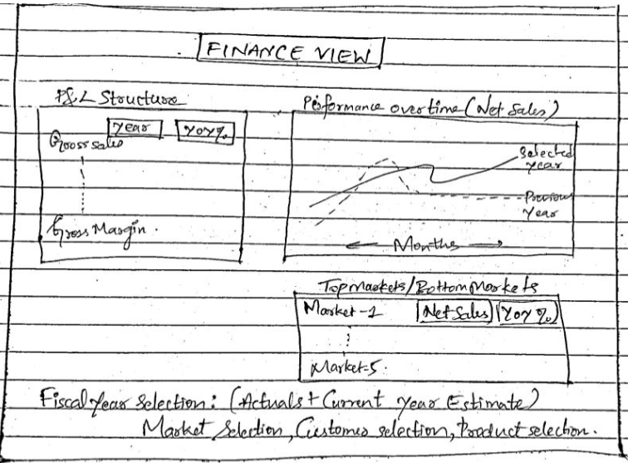
UCD- User Centric Design Mockup Designs:

Slide 13
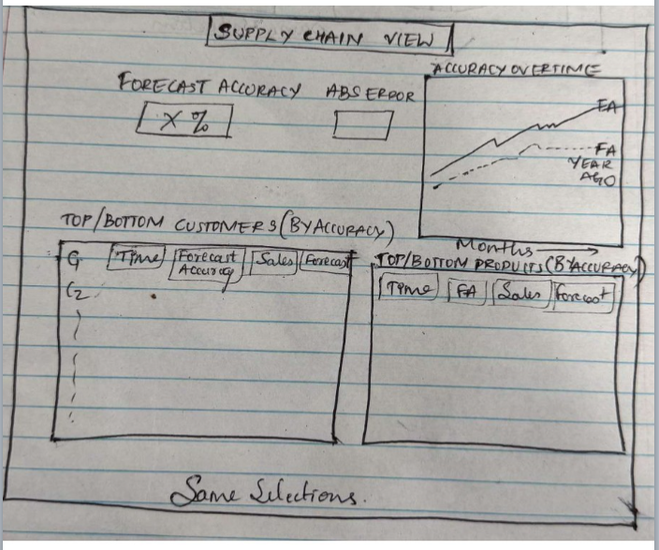

Slide 14
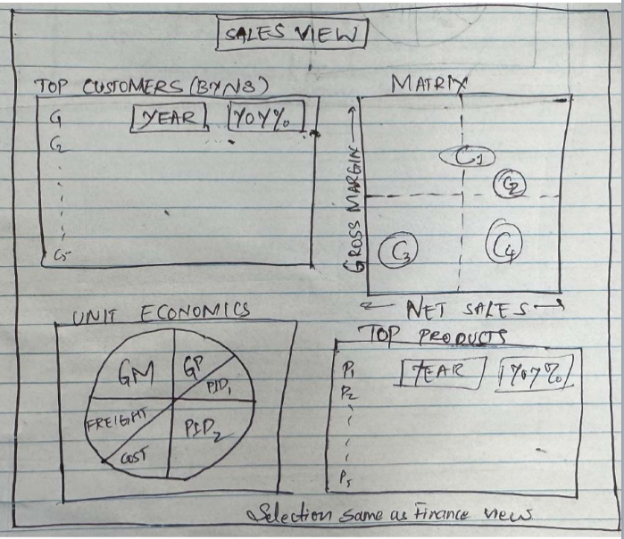

Slide 15
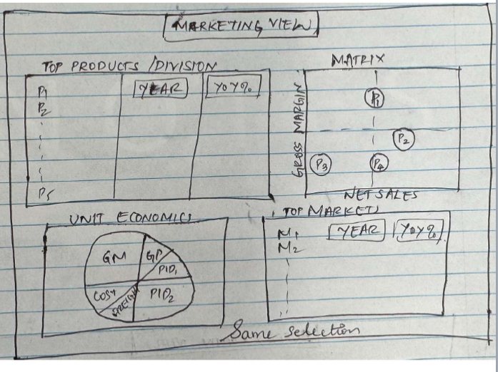

Slide 16
Insights from Analysis
Let's go…

Slide 17

Key Insights & Suggestions for AtliQ Hardware
Revenue–Profit Gap: $3.74B sales, 38.1% GM, but –14% Net Profit due to high expenses and discounts.
Regional Trends: APAC sales strong but profit low (high ad spend); LATAM weak (low promotion).
Customer Margins: Novus eroding GM% with heavy deductions; urgent need for renegotiation.
Supply Chain: 81.2% forecast accuracy, but –3.47M Net Error → stockouts in Amazon, AtliQ e-Store, EI at Sage.
Strategic Priorities: Optimize ad spend, reduce discounts, improve forecasting, balance regional investments, and focus on profitable growth.

